Slide 1
Identifying music features that can define rules in classifying musical themes
CALIMAG, Fritz
MENDOZA, Emir Christopher
NUNCIO, Graciel Myka
ONG, Mitchell
Adviser: DEJA, Jordan Aiko
Notes:
Emir

Slide 2
OUTLINE
Dataset
Litmap
Dynamic Time Warping
Notes:
Emir

Slide 3
DATASET
https://docs.google.com/spreadsheets/d/1NqZSAt9JxVGCAs4u-otssQrv2ljA_JU88H1RcZdbBFc/edit?usp=sharing
Notes:
Emir

Slide 4
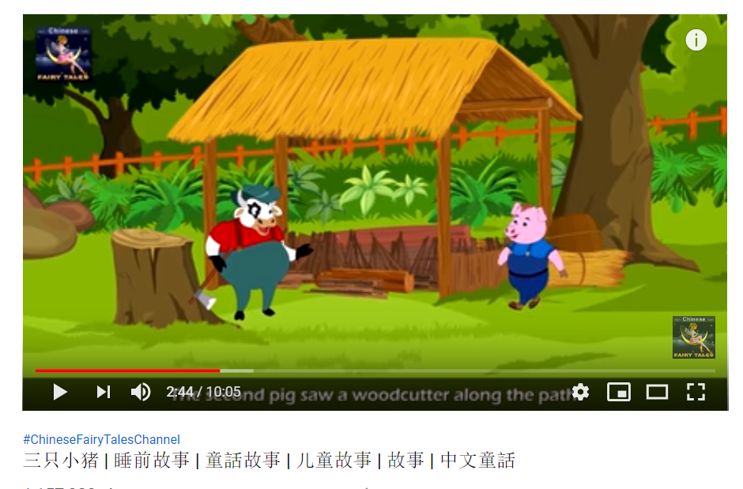
Dataset
Examples
Cheerful
Fearful
Bravery
Love
Notes:
Graciel

Slide 5
LITMAP
https://docs.google.com/drawings/d/1P_3XK7rJXsF7DUWf2NtDj3jg18fnUO5F3KjAlnWepmk/edit?usp=sharing
Notes:
Emir

Slide 6
Dynamic Time Warping
Used to align 2 signals of different length
Finds the best way to map 2 different signals together
Like minimum edit distance but for time series
Notes:
Emir

Slide 7
MUSIC EMOTION RECOGNITION
Music Information Retrieval (MIR) -> Features
Music Emotion Recognition (MER) -> Emotions
Notes:
Emir

Slide 8
CHILDREN’S MUSIC
Building a Model for Music classification in children’s stories using Neural Networks (Kim, 2019)
Gathering different audio samples from videos of Children’s Stories and classifying them into themes.
Notes:
Add examples of childrens stories with background songs
“They show honesty…. They show”
Graciel
We will follow a similar framework to Kim, Clone’s thesis which is (title)
We will be gethering and classifyginh them into 4 themes
Next slide.

Slide 9
CULTURAL DIFFERENCES
People tend to prefer music originating from their own culture (Brittin, 1996)
Cultural stereotypes associated with certain genres (Susino, 2018)
-More familiarity -> Less stereotyped emotions
Notes:
There are many factors to consider when analyzing music preferences and emotion recognition. Cultural differences is one such factor as mentioned in the work of \citeA{brittin1996listeners}. The work of \citeA{clarke2015music} discusses the capability of music to promote empathy and cultural understanding. They presented a model to connect the primary components of music and empathy research, which provides a good overview on how cultural differences are affected by music. People tend to prefer music originating from their own culture as familiarity and repeated exposure affect musical preference. Similarly, people's recognition of themes present in music also differ based on cultural upbringing.
Notes:
https://journals.sagepub.com/doi/pdf/10.1177/0305735618755886
Mitchell

Slide 10
STATEMENT OF THE PROBLEM
Studies on children’s music focus mostly on their psychology and not on application of technology.
Increasing demand for organization of music information (Yang & Chen, 2011)
Limited studies on understanding how cultural differences affect perceiving musical themes
Notes:
1st point =
2nd point = the motivation for MER. instead of classifying via album name, genre, etc. we use emotions
3rd point = cross-cultural comparisons
Mitch

Slide 11
GENERAL OBJECTIVE
To train a model that considers various Fil-Chi cultural influences in selecting themes in children’s stories.
Notes:
Graciel/Mitch

Slide 12
Specific Objective 1
Scope and Limitations
To understand Fil-Chi cultural influences in children’s music by extracting samples of these music files and use them to build a data set.
Selecting a song for children aged 0-8
Extracting music samples that embody a theme
Define a theme for each music sample
The themes will be labelled as in reference to Kim (2019)
Cheerful
Brave
Love
Fearful.
Each theme will have at least 100 music samples
Notes:
Define more what a segment is
Fritz

Slide 13
Specific Objective 2
Scope and Limitations
To build & train multiple machine learning models that aims to classify music for children's stories into four different themes.
A Cross Validation technique called K-fold will be used
The dataset for the model will be split into 3 parts
Training
Testing
Validation
We will use the experiments done by Kim (2019)
Neural Networks
Notes:
Cite clone’s use of neural nets here //follow the protocol used by…
Fritz

Slide 14
Specific Objective 3
Scope and Limitations
To evaluate the performance of the models in terms of its validity and accuracy.
Based on the work of Kim (2019) a comprehensive experiment design will be conducted to validate the correctness and acceptability of the model’s current iteration.
The results will be cross validated with a control group (Filipino People)
Notes:
Fritz

Slide 15
Significance of Research
Educators can gain insight on making or choosing music depending on the theme of the story.
Composers can benefit off the current study when making music according to the theme of the song.
There are limited studies on cross-cultural comparison and children's themes, therefore this will be very useful to researchers who will study on topics related to this research.
Notes:
Graciel

Slide 16

SONG LIST

Slide 17
the motivation on why we’re doing the thesis.
Why?

Slide 18
literature review of previous and existing works and the gaps
What?

Slide 19
proposed methodology with gantt chart all the way until october 2020.
How?

Slide 20
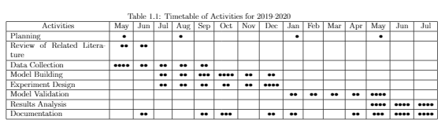
Time Table of Activities

Slide 21


Slide 22
Any Questions?
I dont want questions :< ty
Notes:
Emir

